Slide 1


Introduction to Compilers
A compiler is a specialized program that translates higher-level programming languages into machine code, enabling computers to execute the instructions written by developers. It plays a crucial role in software development, as it allows programmers to write code in a human-readable format while ensuring that it can be executed by the computer.
Compilers are essential for the development of various software applications, from simple scripts to complex operating systems. Understanding the structure and phases of compilers is important for anyone involved in programming and software development.

Slide 2
Lexical Analysis Phase
1
Tokenization
The lexical analysis phase involves tokenization, where the source code is broken down into tokens such as keywords, identifiers, and operators. These tokens form the basic building blocks for the syntax analysis phase.
2
Error Detection
This phase also includes error detection, identifying any lexical errors in the source code and providing meaningful error messages to assist developers in debugging their code.
3
Documentation
During lexical analysis, documentation comments are also processed and stored for later use, enabling tools like documentation generators to produce useful documentation for the codebase.

Slide 3
Syntax Analysis Phase
Parser
Error Reporting
Language Validation
The syntax analysis phase involves the use of a parser to analyze the structure of the source code and ensure that it adheres to the grammar rules of the programming language.
If syntax errors are found, the phase provides detailed error messages to help developers identify and fix the issues, ensuring that the code is syntactically correct.
This phase validates the source code against the formal grammar rules of the programming language, ensuring that the code is well-formed and conforms to the language's syntax.
The parser creates a syntax tree, representing the syntactic structure of the code, which is then used in subsequent phases.

Slide 4

Semantic Analysis Phase
1
Type Checking
2
Semantic Error Detection
3
Syntax-Semantics Interface
The semantic analysis phase performs type checking to ensure that the types of operands used in expressions and statements are compatible, preventing type-related errors during program execution.
It also focuses on detecting semantic errors, such as incorrect variable usage and scope-related issues, enabling developers to catch logic-related bugs early in the development process.
This phase ensures the interface between syntax and semantics, linking the structural rules verified in the syntax analysis phase with the meanings of the constructs in the programming language.

Slide 5



Intermediate Code Generation Phase
Translation
Optimization Opportunities
Error Reporting
This phase involves translating the source code into an intermediate representation, which serves as a bridge between the high-level language and the target machine code.
This phase provides detailed error reporting related to the translation process, enabling developers to identify and resolve issues in the intermediate code.
It identifies opportunities for code optimization, ensuring that the intermediate code is efficient and can be further enhanced in the subsequent optimization phase.

Slide 6

Code Optimization Phase
Performance Enhancement
Resource Utilization
The code optimization phase focuses on enhancing the performance of the generated code, aiming to improve speed and reduce memory consumption without altering the program's functionality.
It optimizes the use of computational resources, ensuring that the generated code makes efficient use of CPU cycles, memory, and other system resources.
Constant Folding
This phase includes techniques like constant folding, which evaluates constant expressions at compile-time, eliminating redundant computations at runtime.

Slide 7
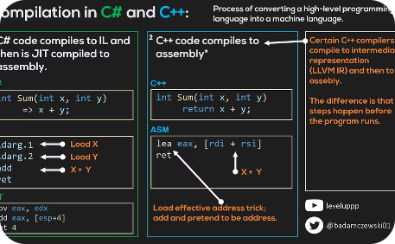
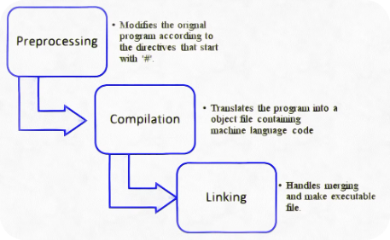
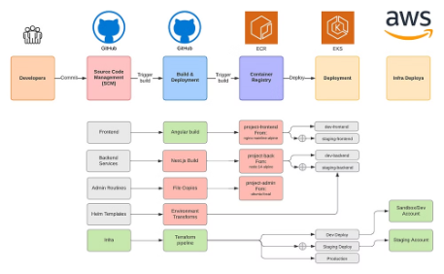
Code Generation Phase
Assembly Code Generation
Machine Code Compilation
Executable Code Production
This phase involves the generation of low-level assembly code that can be directly executed by the target machine, mapping the intermediate code to machine-specific instructions.
It encompasses the conversion of the intermediate code into machine code, which comprises binary instructions that the processor can execute directly.
Finally, the code generation phase produces executable code, allowing the program to be run on the target platform and perform the intended operations.

Slide 8
Conclusion and Key Takeaways
1
2
Complex Process
Optimization Impact
The structure of compilers involves a complex process spanning various phases, each playing a critical role in translating high-level code to executable instructions.
Code optimization significantly impacts the performance and efficiency of the generated executable, making it an essential phase in the compiler structure.
3
4
Error Handling
Machine Code Generation
Effective error detection and reporting during lexical, syntax, and semantic analysis phases contribute to the reliability and stability of the compiled programs.
The final phase of code generation focuses on transforming high-level code into machine-specific instructions, enabling the program to run on the target platform.

